Slide 1
OLD CAR ANALYSIS
NAME : GADDALA ARJUN
Batch : 163

Slide 2
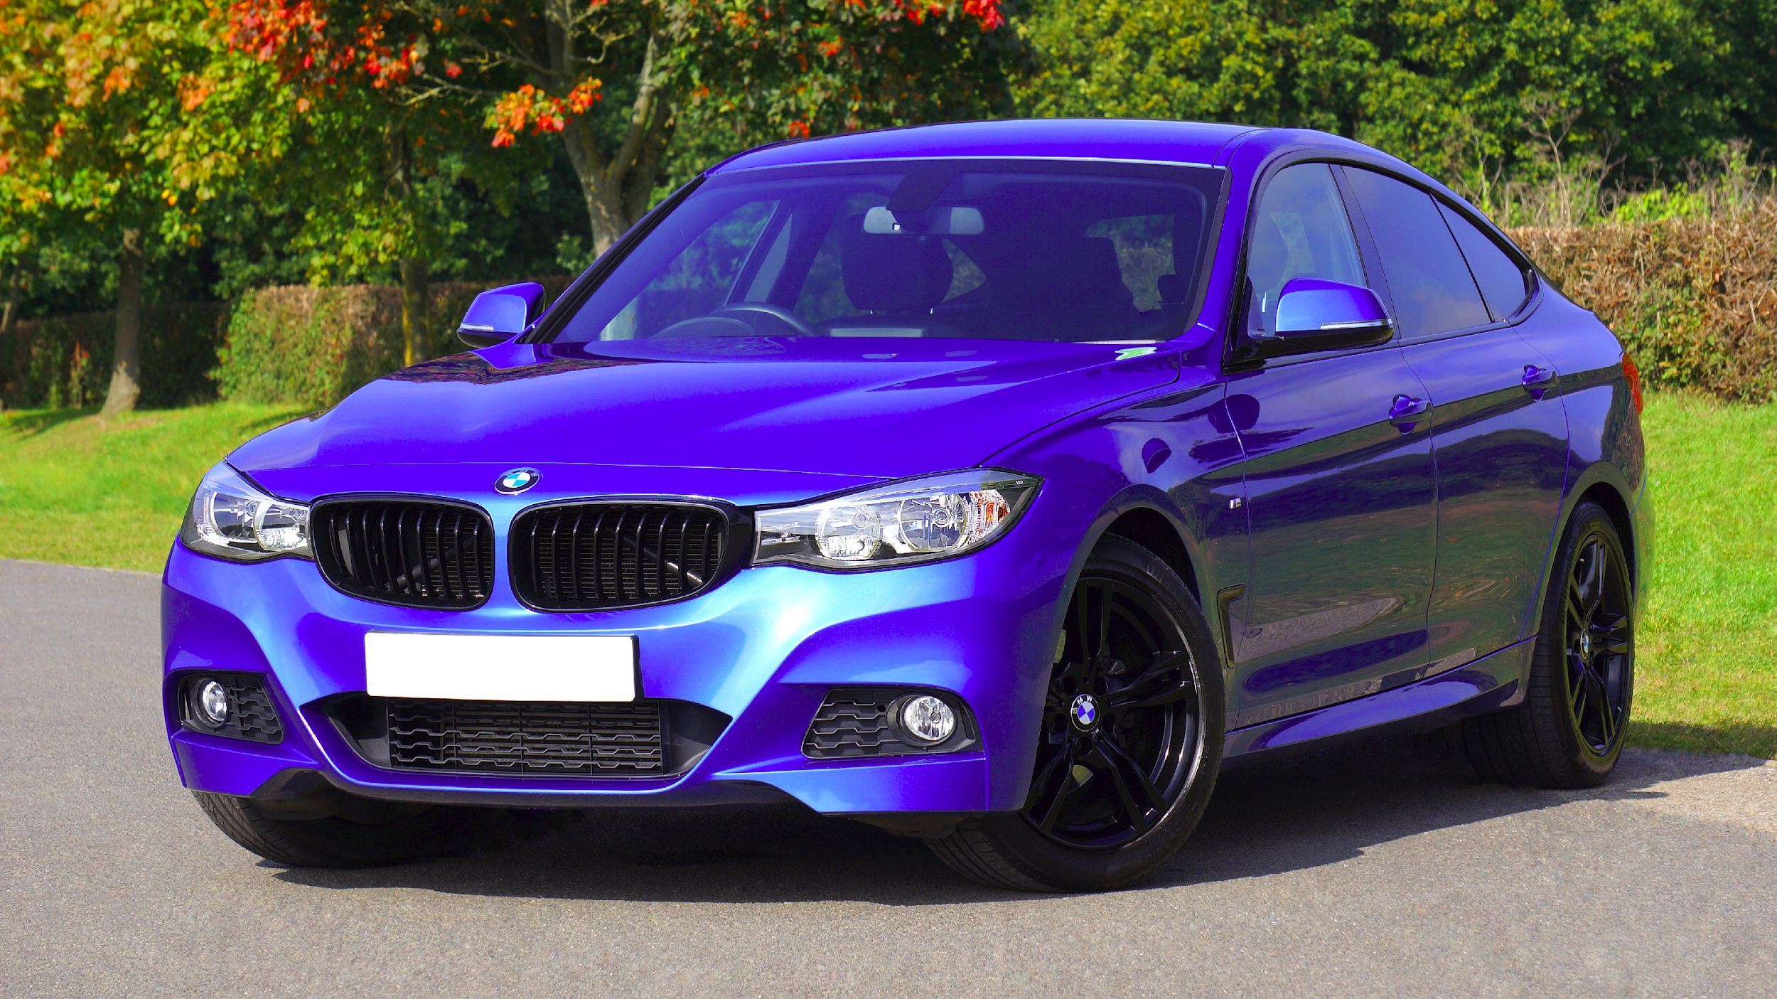
Problem : Find the best old Car
As per today’s market, Finding the best old car with particular specifications is hard for middle class people
In this project,I’m going to find the some best old cars with specifications by my analysis.
Considering by some customer requirements & specifications

Slide 3
STEPS INVOLVED IN ANALYSIS
WEBSCRAPING
DATA COLLECTION
DATA CLEANING
EDA
VISUALIZATION
CONCLUSION

Slide 4
Web Scraping :
Data scrapped from the website : car24/7
After scrapping the whole old cars data from the website, create a dataframe for that data.

Slide 5
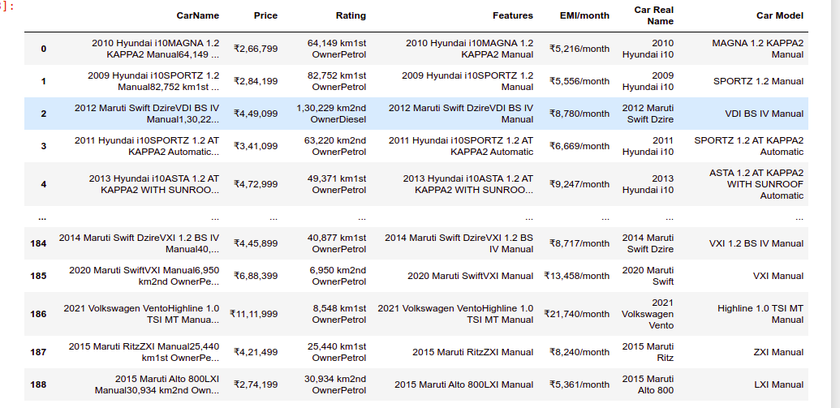
Web Scrapped Image:

Slide 6
Data Cleaning:
Created the new column “Car Brand” using the existing “Car Model” column.
Removed the unwanted symbols & braces in data of each column
And rearranged the index of columns as per anlysis requirements.
Filled the NaN values.

Slide 7
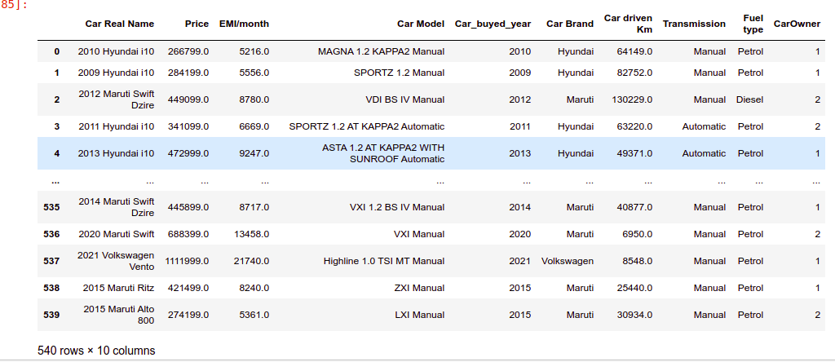
After Data Cleaning:

Slide 8
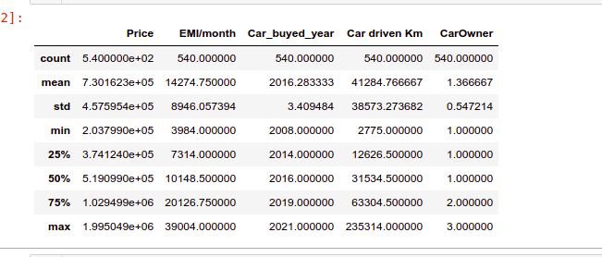
Statistics of the Data

Slide 9
Data Analysis
Univariant Analysis
Bivariant Anslysis
Multivariant Analysis

Slide 10
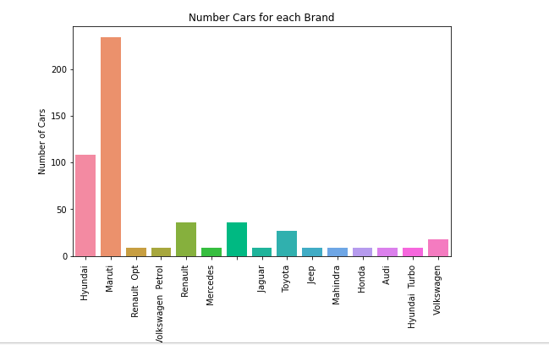
Univariant Analysis
Insights of Brands
This graphs represents the count of models in each brand
This graph show us Maruthi has huge number of Cars

Slide 11
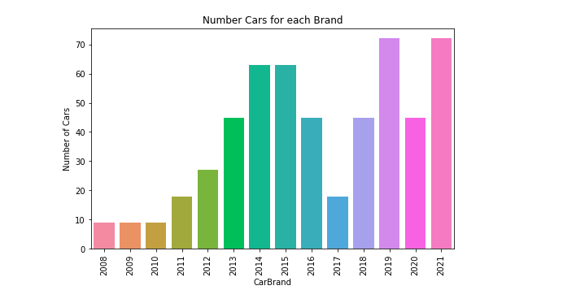
2.Insights of Car Buyed Year
This graph represents the count of Cars buyed year of whole data.
This graph shows us the most of the cars buyed year has 2021

Slide 12
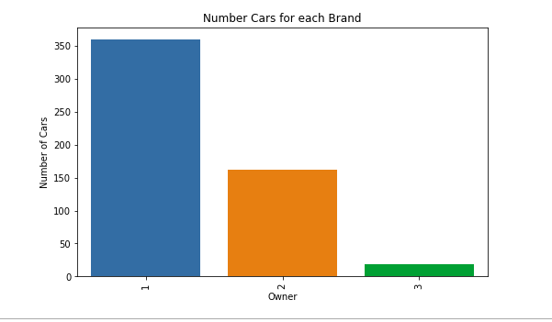
3. Insights of Owners
This graph represents the count of Cars of all owners
This graph shows us the most number of Cars has the owner of First

Slide 13
Bivariant Analysis
1. Analysis on Prices of Car Brand
This graph shows us the which Car has High/low prices

Slide 14
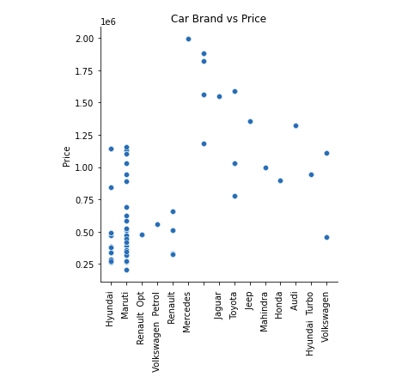
Price of Old Cars vs Car Brand

Slide 15
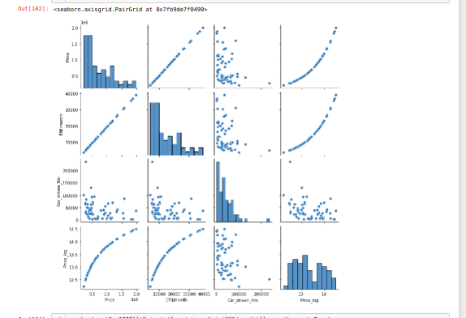
Multi Variant Analysis

